Slide 1


Introduction to Phishing Attacks
Phishing is a type of cyber attack where criminals use deceptive tactics to trick individuals into revealing sensitive information, such as login credentials or financial details. This introductory section will provide an overview of the common techniques used in phishing attacks.

Slide 2
Understanding Phishing Techniques
Email Phishing
Spoofed Websites
Smishing and Vishing
Attackers send fake emails that appear to be from legitimate organizations, requesting the victim to click on a link or provide personal information.
Criminals create realistic-looking websites that mimic trusted brands, aiming to steal login credentials or other sensitive data.
Phishing attacks can also occur via text messages (smishing) or phone calls (vishing), using similar deception tactics.

Slide 3
Common Phishing Tactics
1
Urgent Requests
2
Fake Authority Figures
Phishers often create a sense of urgency to pressure victims into acting quickly without thinking.
Attackers may impersonate trusted organizations or individuals to make their requests seem more legitimate.
3
Emotional Appeals
4
Malicious Links and Attachments
Phishers may use fear, curiosity, or a desire to help to manipulate victims into revealing sensitive information.
Phishing emails often contain links or attachments that, when clicked, can install malware or lead to credential theft.

Slide 4
Identifying Phishing Emails and Websites
Suspicious Senders
Inconsistent Details
Look for email addresses that don't match the organization they claim to represent or appear to be from a generic domain.
Check for spelling and grammar errors, generic greetings, or other signs that the message may not be legitimate.
Unusual Requests
Fake URLs
Be wary of emails or websites that ask for sensitive information, such as login credentials or financial details.
Closely inspect the URL of any website you're directed to, as phishers often use similar-looking domain names.

Slide 5
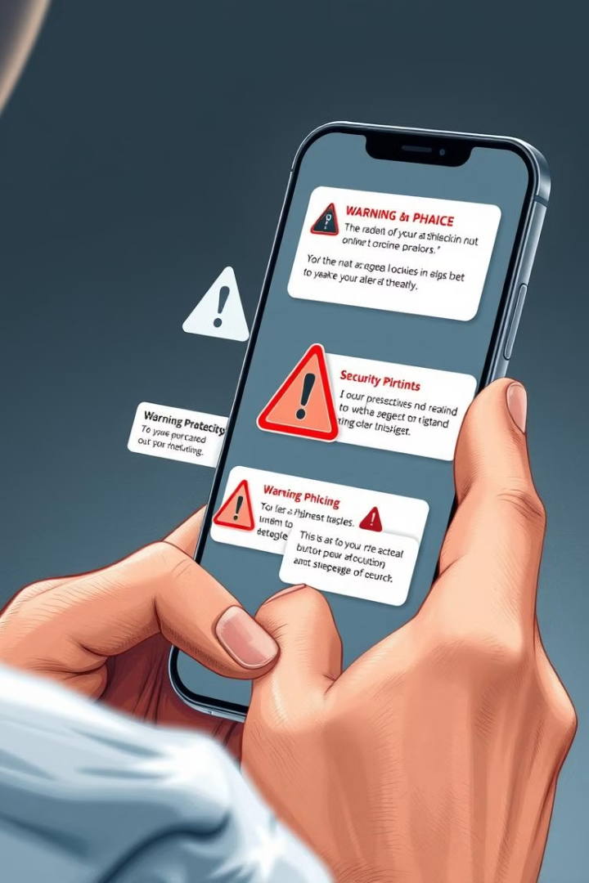
Protecting Yourself from Phishing
1
Be Cautious
Approach all unsolicited emails, text messages, and phone calls with skepticism, and don't rush to respond to urgent requests.
2
Verify Information
Contact the organization directly using a known, trusted method to confirm the legitimacy of any requests for sensitive information.
3
Use Security Tools
Employ strong antivirus software, keep your devices and software up-to-date, and use two-factor authentication whenever possible.

Slide 6



Reporting Phishing Attempts
Report to Your Organization
Notify your employer or service provider about any suspected phishing emails or websites to help prevent others from falling victim.
Report to Authorities
Contact your local authorities or the Federal Trade Commission to report phishing attempts, which can aid in investigation and prevention efforts.
Inform Your Contacts
Warn your friends, family, and colleagues about any phishing scams you've encountered to raise awareness and protect them from similar attacks.

Slide 7
The Impact of Phishing Attacks
Financial Losses
Phishing can lead to stolen funds, identity theft, and other financial crimes that can have a devastating impact on victims.
Reputational Damage
Successful phishing attacks can tarnish the reputation of the targeted organization, eroding trust and credibility.
Malware Infection
Clicking on malicious links or attachments in phishing emails can infect devices with malware, potentially giving attackers access to sensitive data.
Emotional Distress
The fear, anxiety, and stress caused by falling victim to a phishing scam can have a significant impact on an individual's well-being.

Slide 8



Conclusion and Best Practices
Stay Vigilant
Remain alert and cautious when interacting with emails, websites, and communications from unfamiliar sources.
Educate Yourself
Continuously learn about the latest phishing techniques and stay informed on how to identify and protect against them.
Report Incidents
Promptly report any suspected phishing attempts to the appropriate authorities to help prevent further harm.

